Slide 1
Introduction to Bioinformatics
Running
CLUSTAL (W, W2 & Omega) Online
Dr. Muhammad Tahir
Assistant Professor
CUI, Attock Campus

Slide 2
Generating Multiple Sequence Alignments with ClustalW

Slide 3
ClustalW: creating a multiple sequence alignment
It is used for creating a multiple sequence alignment
Clustal W is a general purpose multiple alignment program for DNA or proteins.
ClustalW is used for creating phylogenetic tree.

Slide 4
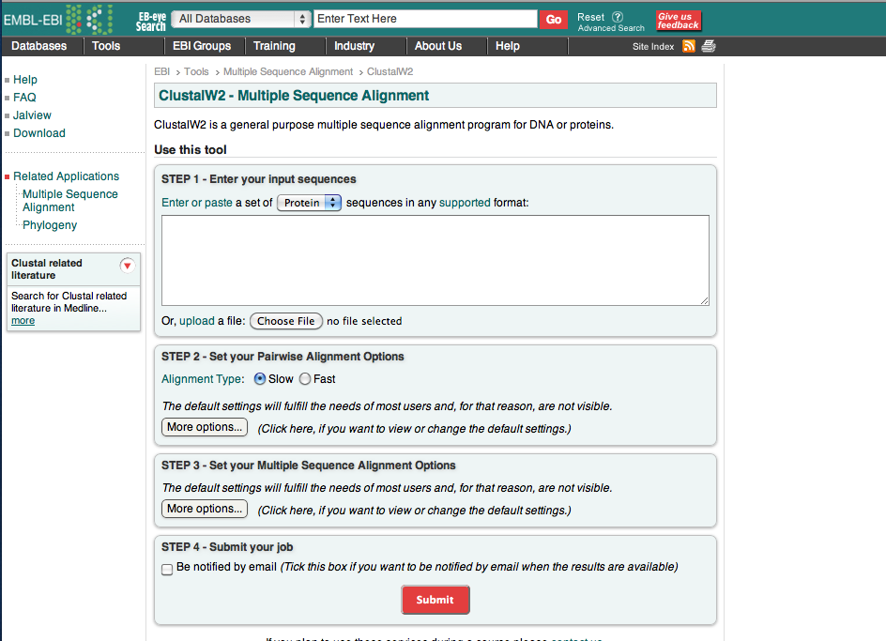
ClustalW: Creating the initial alignment

Slide 5
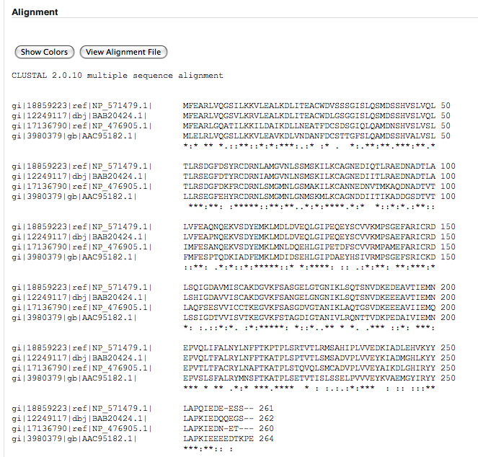
ClustalW: The Alignment Report

Slide 6
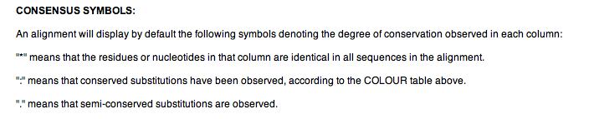
ClustalW: The Alignment Report

Slide 7
ClustalW: The Alignment Report

Slide 8
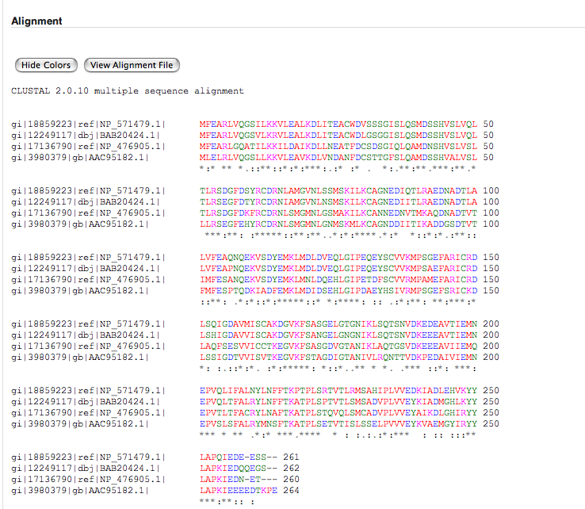

Slide 9
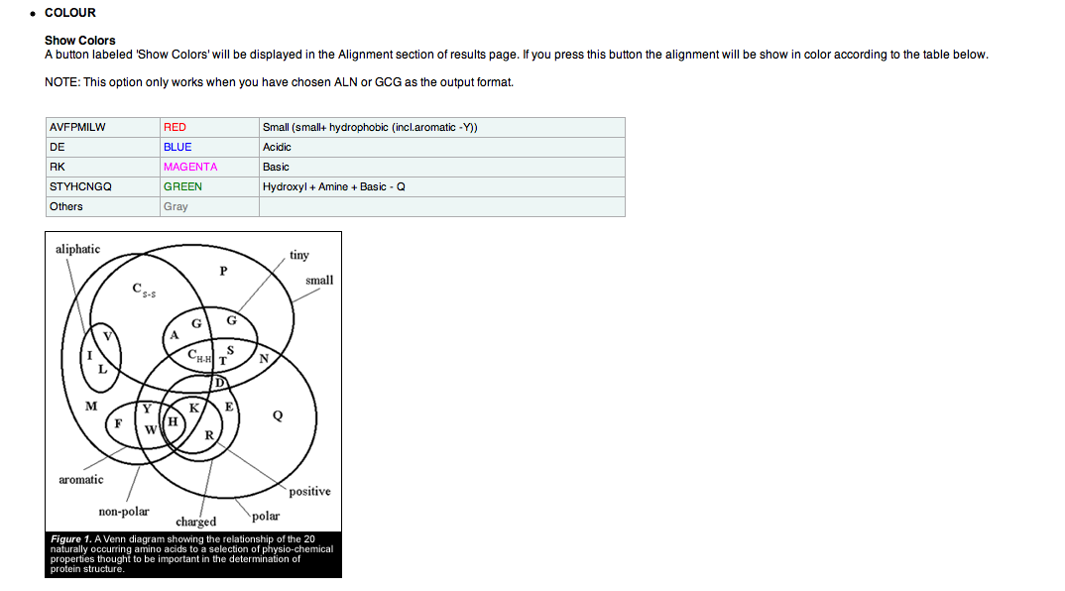
ClustalW: The Alignment Report

Slide 10
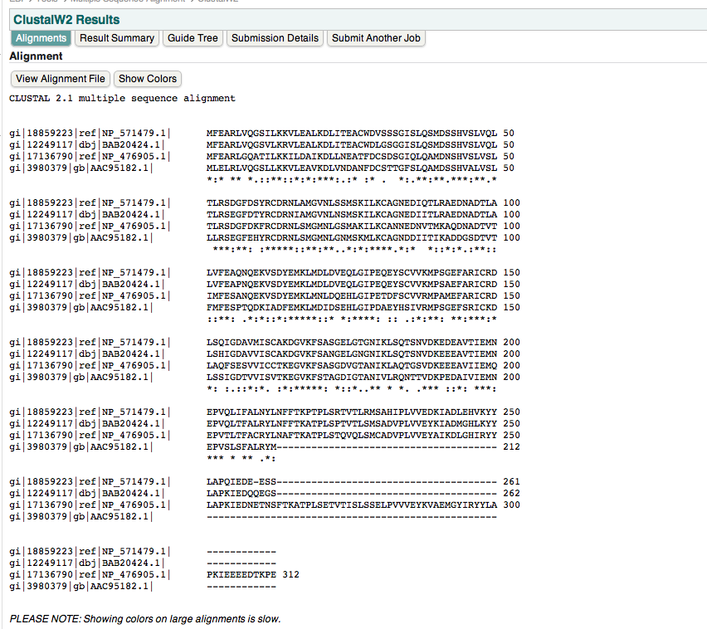
ClustalW: Jalview

Slide 11
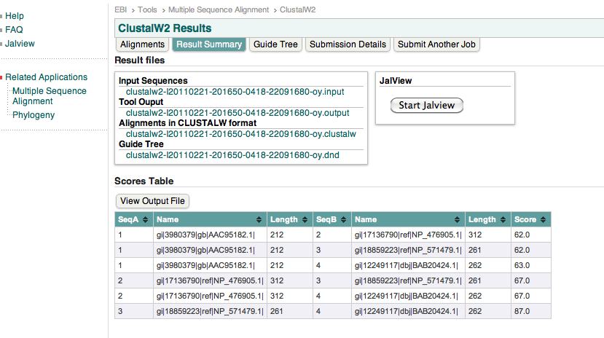
ClustalW: Jalview

Slide 12
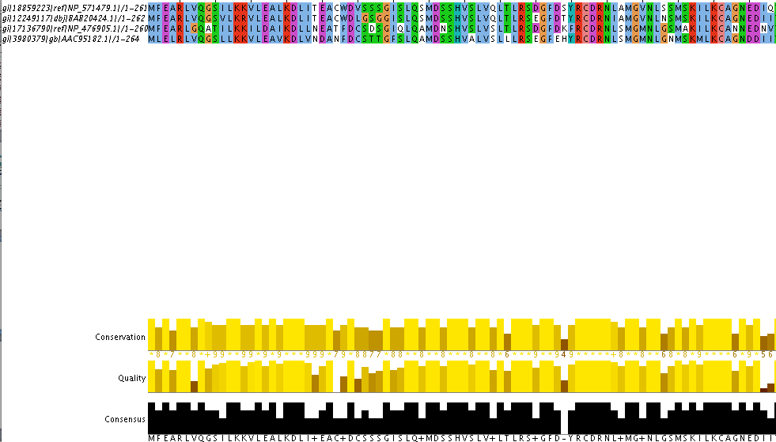
ClustalW: Jalview

Slide 13
ClustalW: creating a phylogenetic tree
ClustalW can only assemble a phylogenetic tree from multiple sequence alignments generated by ClustalW

Slide 14
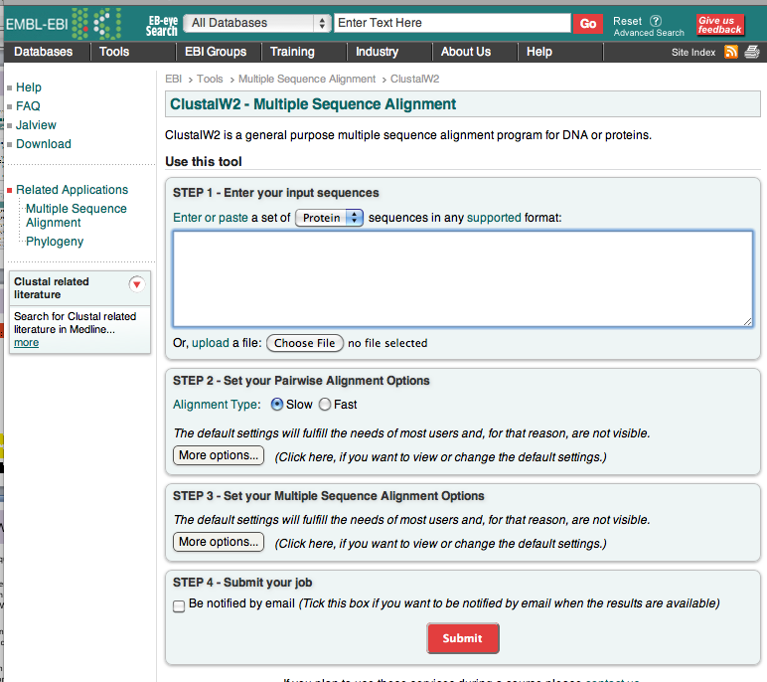
ClustalW: Making a Phylogenetic Tree

Slide 15
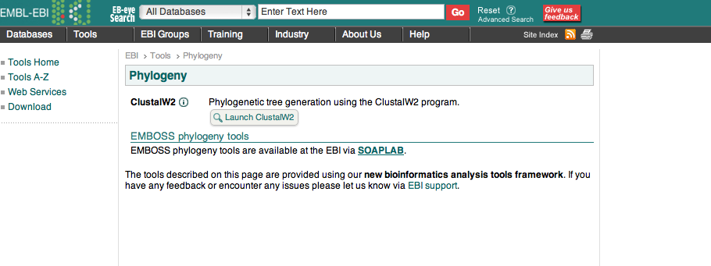
ClustalW: Making a Phylogenetic Tree

Slide 16
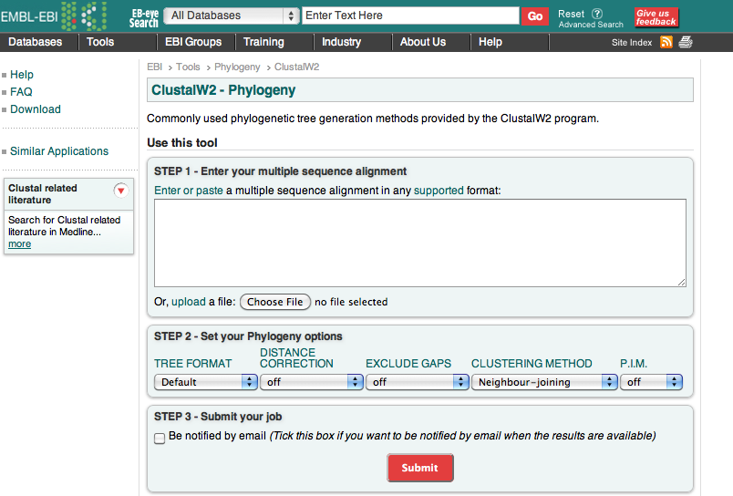
ClustalW: Making a Phylogenetic Tree

Slide 17
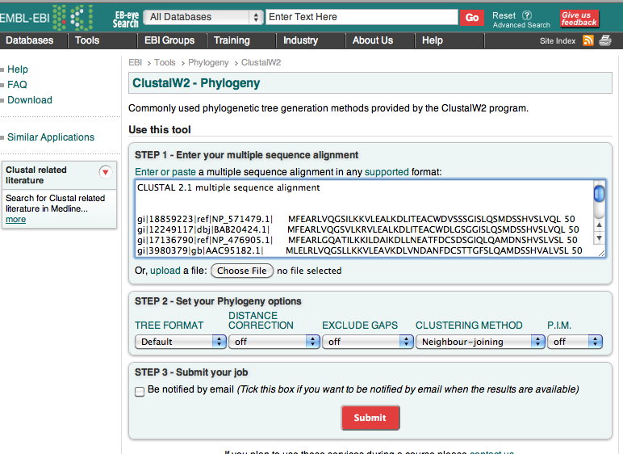
ClustalW: Making a Phylogenetic Tree
Must use Clustal aligned sequences
& include “Clustal” line

Slide 18
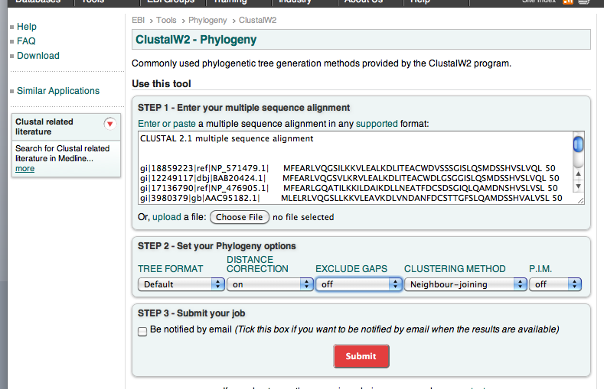
ClustalW: Making a Phylogenetic Tree

Slide 19
ClustalW: Making a Phylogenetic Tree
Phylogram: tree that provides an estimate of a phylogeny, where the branch lengths are proportional to the amount of evolutionary divergence.
Cladogram: tree that provides an estimate of phylogeny where the branches are of equal length: therefore cladograms indicate common ancestry, but do not reflect amount of evolutionary time separating sequences.

Slide 20
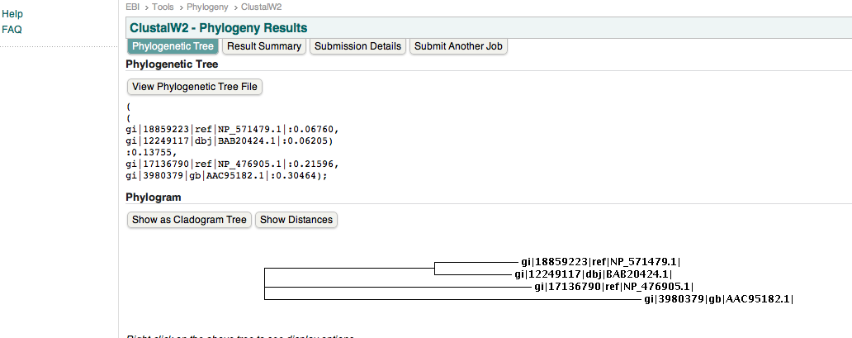
ClustalW: The Phylogram Tree

Slide 21
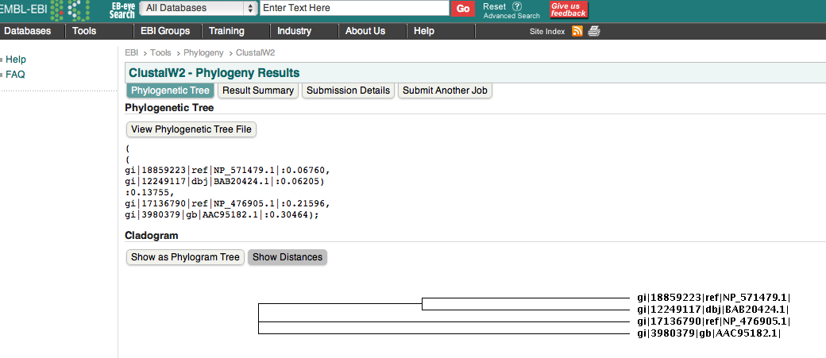
ClustalW: The Cladogram Tree

Slide 22
Generating Multiple Sequence Alignments with Clustal Omega
Clustal Omega
New MSA tool that uses seeded guide trees and HMM profile-profile techniques to generate alignments (protein only). Suitable medium-large alignments.

Slide 23
Clustal Omega: creating a multiple sequence alignment
You identify sequences to align
Get Fasta sequences and copy and paste into window or put all sequences in one document and attach (example: copy and paste into one Word document)
https://www.ebi.ac.uk/Tools/msa/clustalo/

Slide 24
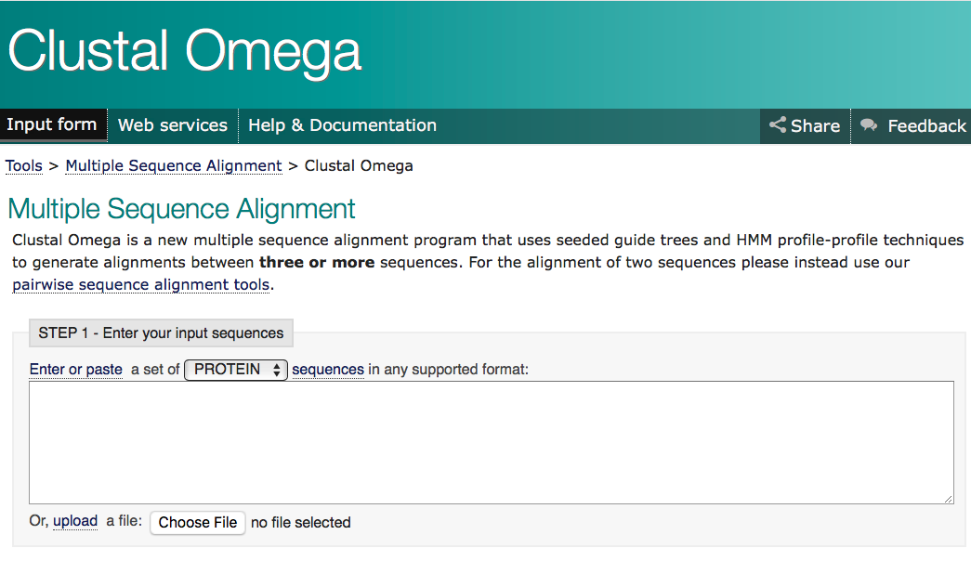
Clustal Omega: Creating the initial alignment

Slide 25
Clustal: The Alignment Report

Slide 26
Clustal: The Alignment Report

Slide 27
Clustal: The Alignment Report

Slide 29
Clustal: The Alignment Report

Slide 30
Clustal: Jalview

Slide 31
Clustal: Jalview

Slide 32
Clustal: Jalview

Slide 33
Clustal: creating a phylogenetic tree
Clustal can only assemble a phylogenetic tree from multiple sequence alignments generated by Clustal

Slide 34
Clustal: Making a Phylogenetic Tree
Phylogram: tree that provides an estimate of a phylogeny, where the branch lengths are proportional to the amount of evolutionary divergence.
Cladogram: tree that provides an estimate of phylogeny where the branches are of equal length: therefore cladograms indicate common ancestry, but do not reflect amount of evolutionary time separating sequences.

Slide 35
END

